Slide 1
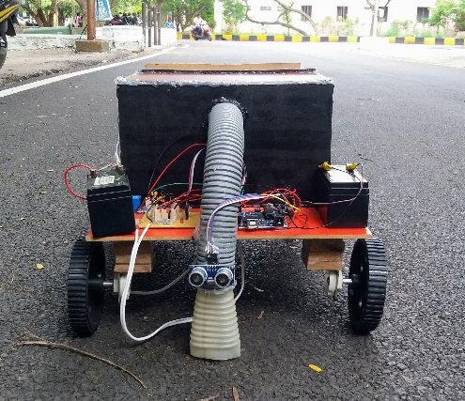
Automated Cleaning System

Slide 2
PROBLEM BEING ADDRESSED & SOLUTION
PROBLEM: To clean railway stations , car parking slots, household, roads.
SOLUTION: An Automated Cleaning system which cleans garbage over floor. It runs with an battery power and consist of suction machine which sucks the dust as well as garbage over the platform.

Slide 3

PRODUCT WORKING
The robot which is automated. It consists suction machine, Arduino board and two types of sensors which are anti-collision obstacle sensor, Ultrasonic sensor.
The robot works in an zigzag mode.
The robot stops when it detects an obstacle.

Slide 4
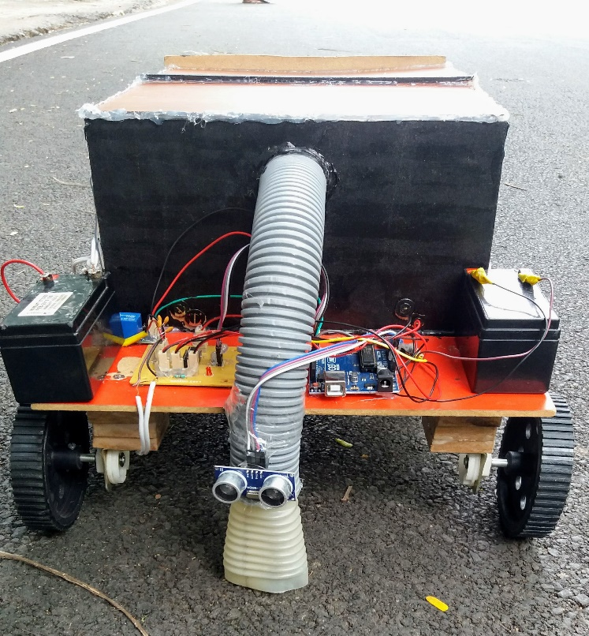
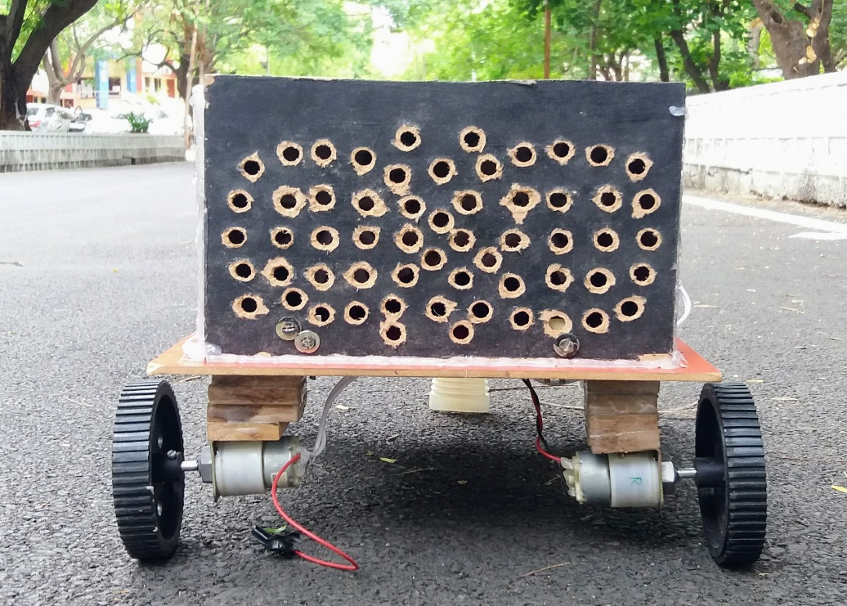
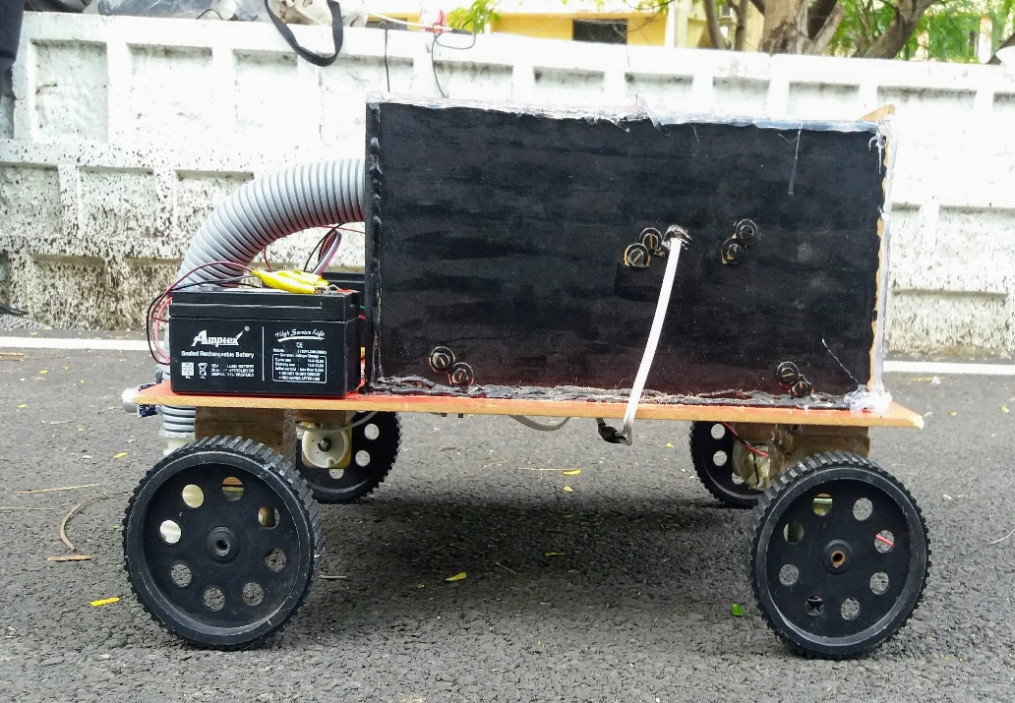
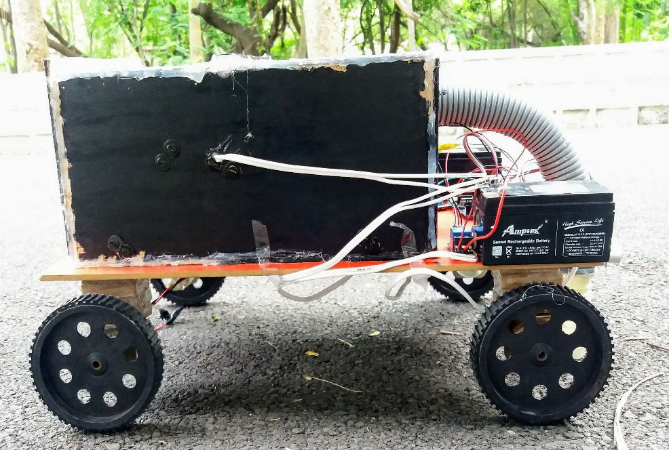

Slide 5
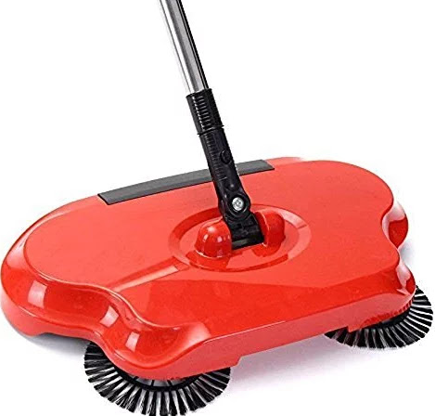
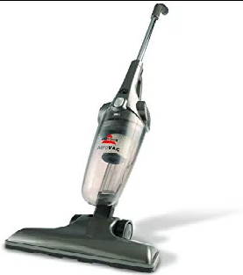
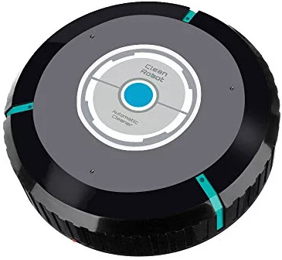
EXISTING SYSTEM
Cleans only small dust particles.
Time comsuming Process(Manual cleaning).
Cost Effective.

Slide 6
UNIQUENESS
Less Cost
Capable of cleaning dust, garbage, jitter.
Comparatively takes less time to clean.

Slide 7
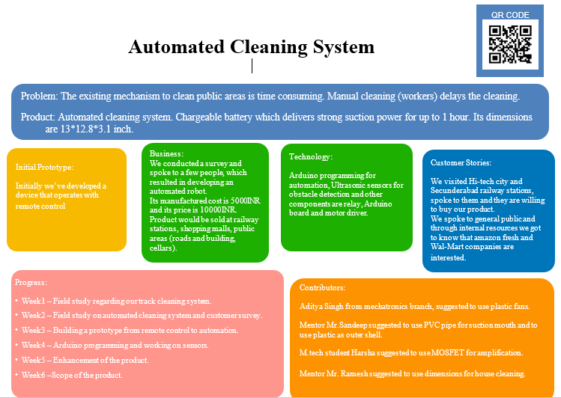

Slide 8
MARKET
Our customers will be RRB, R&B, Municipality and GHMC.
Our prospective customers are all railway stations, GHMC.
Around 1-2 products to a single railway station and 2-3 products to municipality, R&B we can address now.

Slide 9
COMPETITION
Manual working process, Semi-automated devices, vacuum cleaners are our competitors.
Our competitors are the one who develop the product for Indian railways, GHMC.
As there is no automated product to clean, so there is only one possibility to use their product which is manual cleaning.
Our product is of minimal size and automation which requires only one person to monitor it. So, that is how we are different from our competitors.

Slide 10
MARKETING STRATEGY
We will be using social networking sites such as twitter, facebook, instagram etc to promote our product. So, that it can reach to public.
We may try to contact some people who are under ministry of railway, R&B,GHMC.

Slide 11
REVENUE MODEL
Our revenue source is the government and public.
Price of our product is 10000 INR.
FINANCIALS
It takes around 5000 INR for making the product.

Slide 12
TEAM CAPABILITIES
Team Lead and Members: Ch.Sudheshna Sai(Team Lead)
Akanksha Jhadi
Deshetty Suma
D.Keerthi Priya
I.Jyothi Bhavani
Team qualifications/skills and role :
Ch.Sudheshna Sai : Idea Generation, Enhancement of the product and Tech support.
Akanksha Jhadi : Idea Generation and Development of Idea
Deshetty Suma : Idea Generation, Understanding the Requirements and Marketing.
D.Keerthi Priya : Understanding and Marketing department.
I.Jyothi Bhavani : Understanding and Marketing department.

Slide 13
Thank you!

Slide 14
Any Queries?

